Slide 1


Tomasz Kostuch
6/10/2021

Slide 2

Outline
Executive Summary
Introduction
Methodology
Results
Conclusion
Appendix

Slide 3
Executive Summary
The Methodologies used include:
Data collection
Data Wrangling
EDA with Data Visualisation
EDA with SQL
Building an Interactive Map with Folium
Building an Interactive Dashboard with Plotly Dash
Predictive Analysis
Summary of Results:
EDA of Results
Interactive Analysis Demo with Screenshots
Predictive Analysis

Slide 4
Introduction
Project background and context
The aim of the project was to predict if the Falcon 9 first stage would land successfully. Space X advertises Falcon 9 rocket launches on its website with a cost of $62 million; other providers cost upward of $165 million each, the reason for most of this saving is that Space X can reuse the first stage. Therefore, if we can determine if the first stage will land, we can determine the cost of a launch. This information can also be used by alternate companies that want to bid against Space X for a rocket launch.
Key Questions
What factors influence the rocket landing successfully?
The impact of the different rocket variables on success rate of the rocket landing
What are the optimal conditions that ensure the SpaceX rocket has the best chance of landing?

Slide 5


Slide 6
Methodology
1. Data collection:
Data collection was performed using:
Space X Rest API
Web Scraping from Wikipedia
2. Data Wrangling:
The data was transformed to make it suitable for Machine learning:
Performing one Hot encoding on data fields to express each categoric variable as a binary vector
Dropping irrelevant columns and dealing with missing values appropriately
3. Exploratory Data Analysis (EDA) using Visualization and SQL
EDA was performed by plotting Bar and Scatter Graphs to visualize the relationships between the rocket variables, and identify any patterns in the data.
SQL queries were used to drill down into the relationships between different variables.
4. Interactive Visual Analytics using Folium and Plotly Dash
5. Predictive Analysis using Classification Models
How to build, tune, evaluate classification models

Slide 7
Data Collection
The Space X launch data was gathered using the Space X Rest API and Web scraping of Wikipedia:
Space X Rest API:
The data contained information relating to; the type of rocket, the payload used, launch specifications, landing specifications and the outcome of the landing
Web Scraping:
The data obtained specifically focused on the Falcon 9 Launch and Landing Information
Request Data using Space X Rest API
Parse the Space X launch data in JSON
Normalise the data into a flat csv file
Request HTML response from Wikipedia
Create BeautifulSoup object from HTML response
Extract and parse relevant launch data from soup object to Dataframe

Slide 8
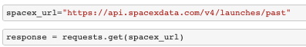
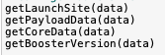
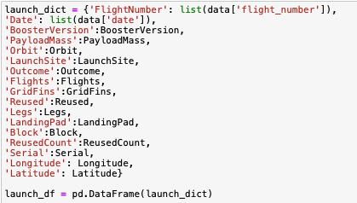
Data Collection – SpaceX API
Get Response from API
2. Convert response to JSON
3. Clean Data using custom functions
4. Create Dataframe
5. Filter Dataframe and Export Data to CSV
Parse the Space X launch data in JSON
Request Data using Space X Rest API
Cleaning and Filtering Data
Export Normalised data to a CSV file
GITHUB URL to NOTEBOOK
Notes:
https://github.com/brunkrisla/SPACE_X_PROJECT/blob/main/Data%20Collection%20.ipynb

Slide 9
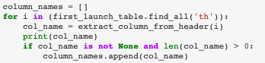
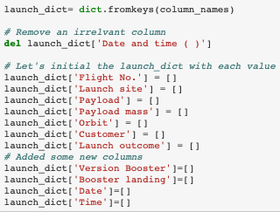
1. Get response from HTML
2. Create Beautiful Soup Object
3. Find Data using tables and obtain column names
4. Extract Data by appending to dictionary (See in notebook by following Github URL)
5. Create Dataframe using Dictionary
6. Export Dataframe to CSV file
Data Collection - Scraping
Create Beautiful Soup object from HTML response
Request HTML response from Wikipedia
Extract and parse relevant launch data from soup object to Dataframe
Export Normalised data to CSV File
GITHUB URL to NOTEBOOK

Slide 10
Data Wrangling
Summary
During Data Wrangling Exploratory Data Analysis (EDA) identified patterns in the data and the necessity transforming certain variables to appropriate labels that could be used for training supervised models. For example, the dataset possessed several different cases where the booster did not land successfully. Sometimes a landing was attempted but failed due to an accident; for example, True Ocean means the mission outcome was successfully landed to a specific region of the ocean while False Ocean means the mission outcome was unsuccessfully landed to a specific region of the ocean. The main focus of the data transformation was to convert those outcomes into Training Labels with; 1 meaning the booster successfully landed, and 0 meaning it was unsuccessful.
Process
GITHUB URL to NOTEBOOK
EDA on the Dataset
Calculating the number of launches on every site
Calculating the number of different mission outcomes per orbit type
Creating landing outcome labels
Calculating the occurrences of each orbit
Export Data as CSV
STAGE 1
STAGE 2
STAGE 3

Slide 11
EDA with Data Visualization
Several scatter graphs were plotted to visualise the correlation between the different variables, and further explore the relationship between them
A line graph was used to visualise the trend in the success rate of launching rockets over time
A bar graph was used to explore how the success rate changed with different orbit types.
GITHUB URL to NOTEBOOK

Slide 12

EDA with SQL
Various SQL queries were performed to gather information from the dataset
In certain cases, the queries were used to drill down into the data, a comprehensive list of the queries that were performed is located below:
Display the names of the unique launch sites in the space mission
Display 5 records where launch sites begin with the string 'CCA'
Display the total payload mass carried by boosters launched by NASA (CRS)
Display average payload mass carried by booster version F9 v1.1
List the date when the first successful landing outcome in ground pad was achieved
List the names of the boosters which have success in drone ship and have payload mass greater than 4000 but less than 6000
List the total number of successful and failure mission outcomes
List the names of the booster versions which have carried the maximum payload mass. Use a subquery
List the failed landing outcomes in drone ship, their booster versions, and launch site names for in year 2015
Rank the count of landing outcomes (such as Failure (drone ship) or Success (ground pad)) between the date 2010-06-04 and 2017-03-20, in descending order
GITHUB URL to NOTEBOOK

Slide 13
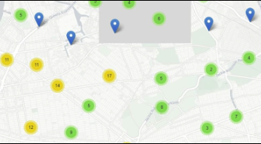
Build an Interactive Map with Folium
Visualising the Launch Data on an Interactive Map
The longitude and latitude was taken at each site and used with the Circle object to add a Circle Marker for each launch site to the map.
Assigning Launch Outcomes to Classes
Failures and Successes were mapped to 0 and 1 respectively, those classes were then used to colour the markers that were added to the interactive map by using a MarkerCluster()
Calculating the Distance from Various Landmarks to the Launch Sites
These distances were used to explore potential trends between the proximity of launch sites to landmarks such as; cities, railways or highways. Lines were drawn on the map to visualise the distance. The trends explored are detailed in the results.
GITHUB URL to NOTEBOOK

Slide 14
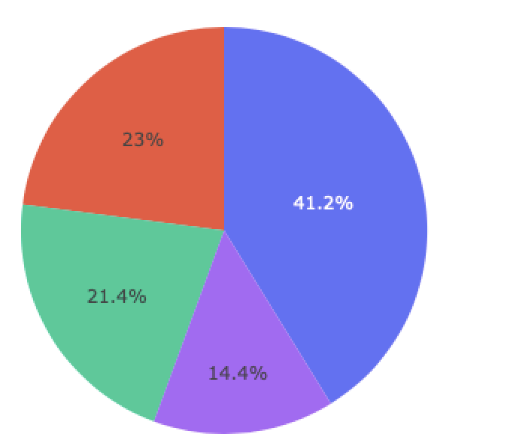
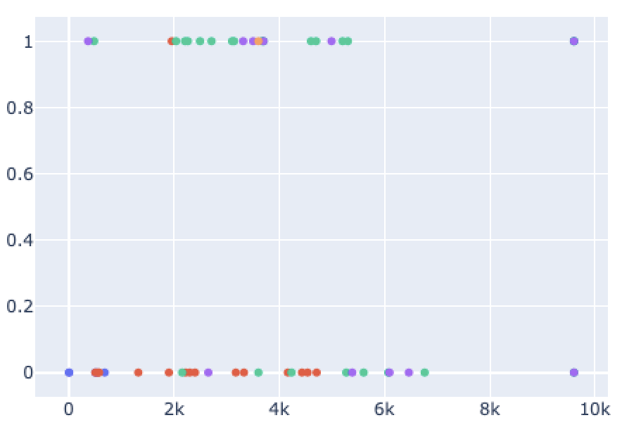
Build a Dashboard with Plotly Dash
Dash was used to create an interactive dashboard containing a variety of plots exploring the relationship between; landing outcome, number of launches from the sites, booster version, and Payload Mass.
Graphs
A Pie chart is located at the top of the dashboard visualising the breakdown of the number of launches from each or every site.
A scatter graph is located at the bottom of the dashboard displaying the relationship between landing outcome and payload mass for different booster versions. The range of the payload mass can be altered to explore how that particular variable affects landing outcome.
GITHUB URL to DASH SCRIPT

Slide 15

Predictive Analysis (Classification)
Building Model
Loading Dataset into NumPy and Pandas
Evaluating Model
Calculate accuracy of each ML Model
Improving Model
Engineer features and tune algorithm
Finding Best Performing Model
Transforming Data
Splitting data into training and test sets
Select Machine Learning (ML) algorithm to use
Set parameters to tune in GridSearchCV
Fit ML algorithms and train them on training data
Identify best parameters in GridSearchCV for each algorithm
Plot Confusion Matrix
Calculate the F1 and Jaccard scores for each model
Create table and graph comparing the metrics of each model
GITHUB URL to NOTEBOOK

Slide 16

Results
Exploratory Data Analysis Results: Visualisation, SQL
Interactive analytics demo in screenshots
Predictive analysis results

Slide 17


Slide 18
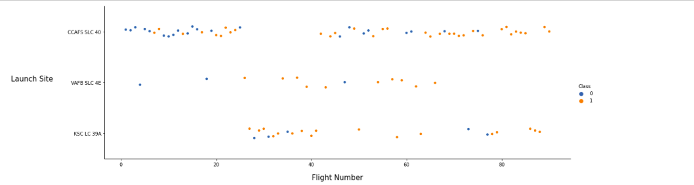
Flight Number vs. Launch Site
Observations
1. The first 6 flights all resulted in failures with the last 13 being successful. May suggest that as time has progressed, we have got better at achieving successful launches.
2. CCAFS SLC 40 launch site has the most launches when compared with the other two sites
3. Comparatively the VAFB SLC 4E and KSC LC 39A have a higher success rate then CCAFS SLC 40
4. During a period of no flights from CCAFS SLC 40, KSC LC 39A flights started being launched and more flights were also launched from VAFB SLC 4E

Slide 19
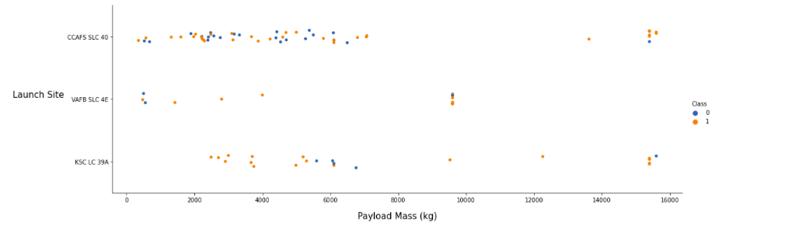
Payload vs. Launch Site
Observations
Higher payload masses have a higher rate of success then the low payload masses
Appears to be certain payload weights that have been used as a standard across multiple launches (especially around 10000 and 15000), they can be seen on the graph forming almost straight lines
3. The low payload masses launched from KSC LC 39A were successful

Slide 20
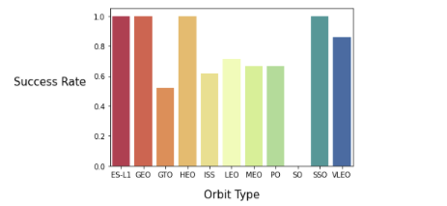
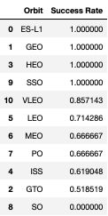
Success Rate vs. Orbit Type
Observations
ES-L1, GEO, HEO AND SSO are the standout performers with a 100% success rate
Then; VLE0, LEO, MEO and PO,ISS, GTO
3. The worst performer with 0% success rate is SO

Slide 21
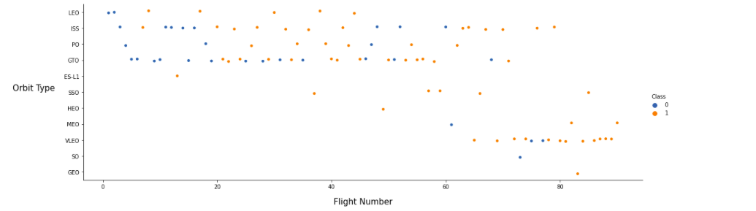
Flight Number vs. Orbit Type
Observations
The LEO orbit the Success appears related to the number of flights; on the other hand, there seems to be no relationship between flight number when in GTO orbit.

Slide 22
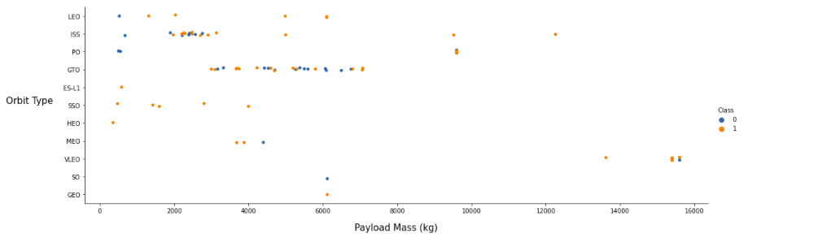
Payload vs. Orbit Type
Observations
Heavy payloads have a negative influence on GTO orbits and positive on GTO and Polar LEO (ISS) orbits.

Slide 23
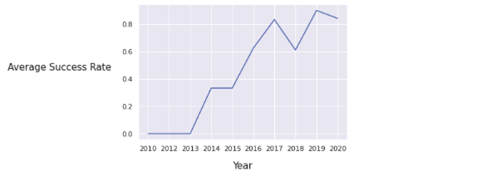
Launch Success Yearly Trend
Observations
Average Success rate has kept increasing from 2013 to 2020, with a slight decrease during 2018.

Slide 24

EDA with

Slide 25
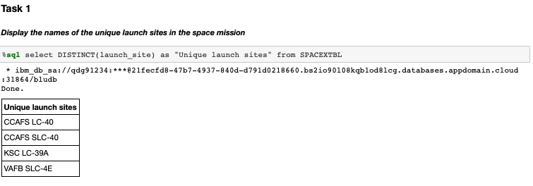
All Launch Site Names
SQL QUERY:
select DISTINCT(launch_site) as "Unique launch sites" from SPACEXTBL

Slide 26
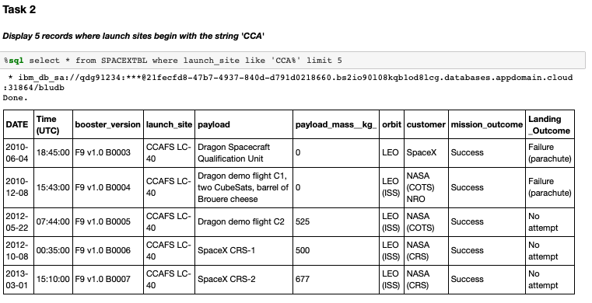
Launch Site Names Begin with 'CCA'
SQL QUERY:
select * from SPACEXTBL where launch_site like 'CCA%' limit 5

Slide 27
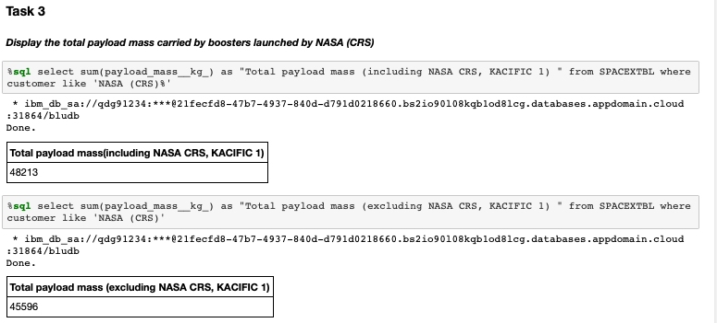
Total Payload Mass
SQL QUERY:
select sum(payload_mass__kg_) as "Total payload mass (including NASA CRS, KACIFIC 1) " from SPACEXTBL where customer like 'NASA (CRS)%’
Or
select sum(payload_mass__kg_) as "Total payload mass (excluding NASA CRS, KACIFIC 1) " from SPACEXTBL where customer like 'NASA (CRS)'

Slide 28
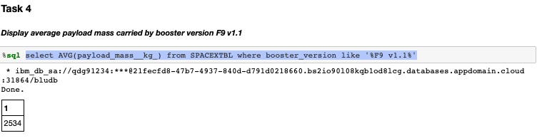
Average Payload Mass by F9 v1.1
SQL QUERY:
select AVG(payload_mass__kg_) from SPACEXTBL where booster_version like '%F9 v1.1%'

Slide 29
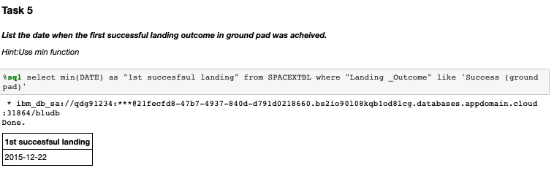
First Successful Ground Landing Date
SQL QUERY:
select min(DATE) as "1st succesfsul landing" from SPACEXTBL where "Landing _Outcome" like 'Success (ground pad)'

Slide 30
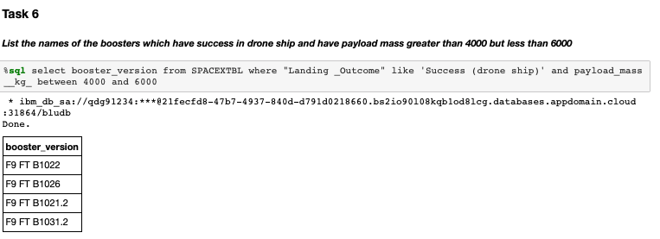
Successful Drone Ship Landing with Payload between 4000 and 6000
SQL QUERY:
select booster_version from SPACEXTBL where "Landing _Outcome" like 'Success (drone ship)' and payload_mass__kg_ between 4000 and 6000

Slide 31
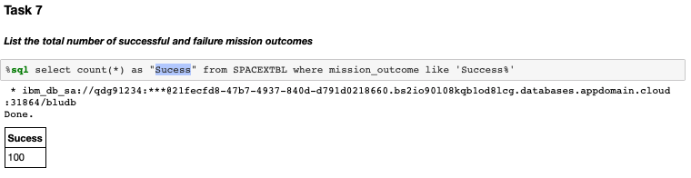
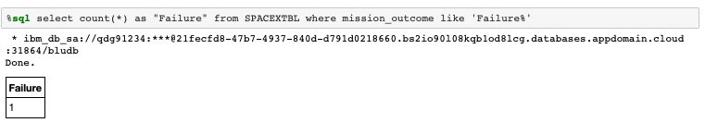
Total Number of Successful and Failure Mission Outcomes
SQL QUERY:
select count(*) as "Sucess" from SPACEXTBL where mission_outcome like 'Success%’
select count(*) as "Failure" from SPACEXTBL where mission_outcome like 'Failure%'

Slide 32
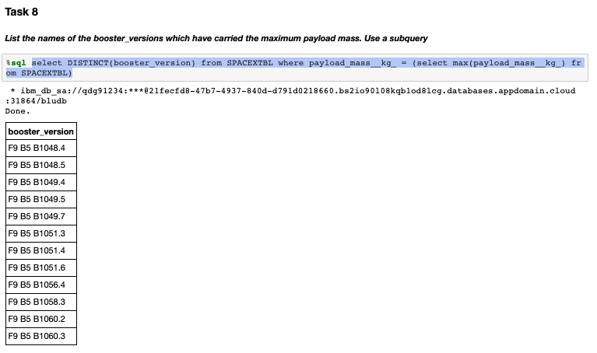
Boosters Carried Maximum Payload
SQL QUERY:
select DISTINCT(booster_version) from SPACEXTBL where payload_mass__kg_ = (select max(payload_mass__kg_) from SPACEXTBL)

Slide 33
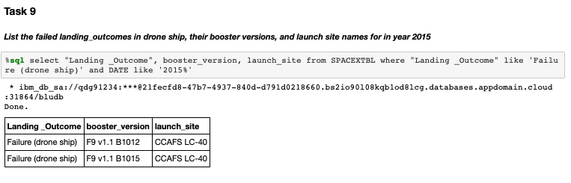
2015 Launch Records
SQL QUERY:
select "Landing _Outcome", booster_version, launch_site from SPACEXTBL where "Landing _Outcome" like 'Failure (drone ship)' and DATE like '2015%'

Slide 34
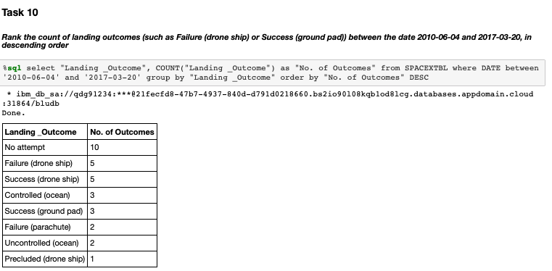
Rank Landing Outcomes Between 2010-06-04 and 2017-03-20
SQL QUERY:
select "Landing _Outcome", COUNT("Landing _Outcome") as "No. of Outcomes" from SPACEXTBL where DATE between '2010-06-04' and '2017-03-20' group by "Landing _Outcome" order by "No. of Outcomes" DESC

Slide 35


Slide 36
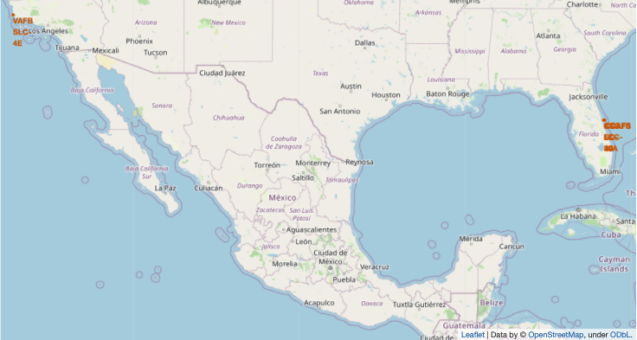
Launch Sites on Global Map
Space X Launch Sites located in Florida(x1) and California(x3)

Slide 37
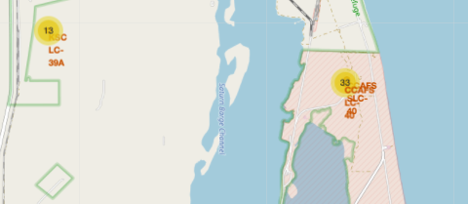
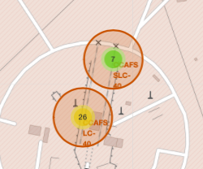
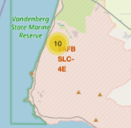
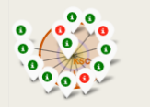
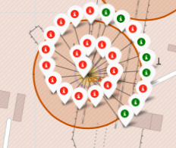
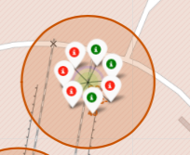
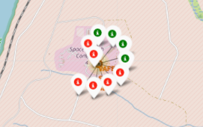
Coloured Labelled Markers: Success and Failure
Florida Sites: KSC LC-39A, CCAFS LC-40, CCAFS SLC-40
California Site: VAFB SLC-4E
KSC LC-39A
CCAFS SLC-40
CCAFS LC-40
Green Icon markers represent successful launches and Red Icon markers represent failed launches
VAFB SLC-4E

Slide 38
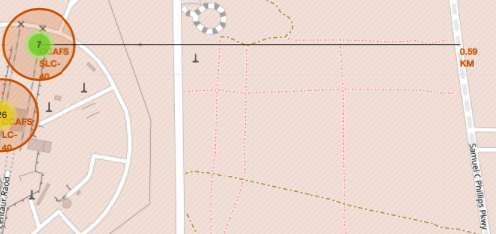
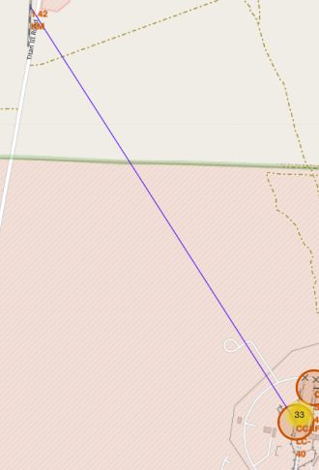
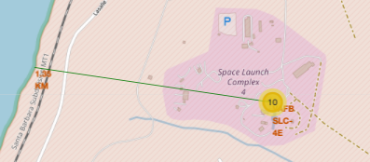
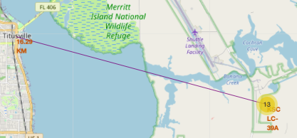
Launch Sites Proximity to Cities, Railways, and Highways
Distance to Highway
Distance to Coastline
Observations
Are launch sites in close proximity to; railways, highways, and coastlines?
They are in close proximity to all of those:
To the coastline so they can launch rockets with the added layer of safety of the ocean
They are relatively close to railways and highways as people need to get in and out of the launch sites for work, also if something wen wrong they may need an easy to to evacuate the sites
Do launch sites keep certain distance away from cities?
They are likely situated away from cities to reduce the threat to populated areas and any noise disruption that may occur
Distance to Railway
Distance to City

Slide 39


Slide 40
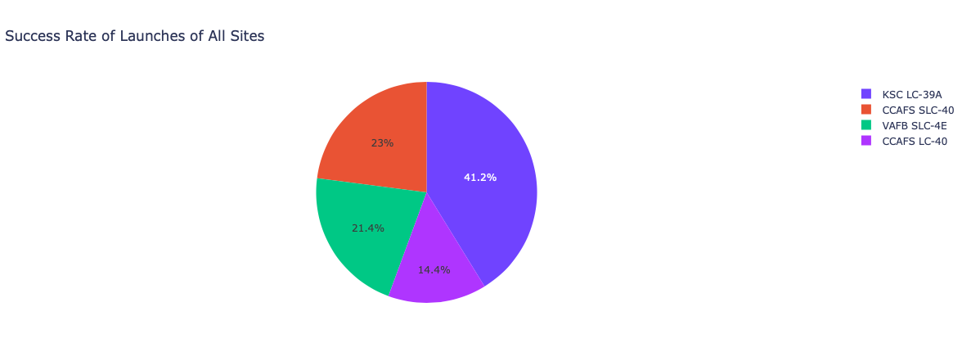
Dashboard: Success Rate Achieved by all Sites
Observations
KSC LC-394 had the highest successful rate when compared with the other sites.

Slide 41
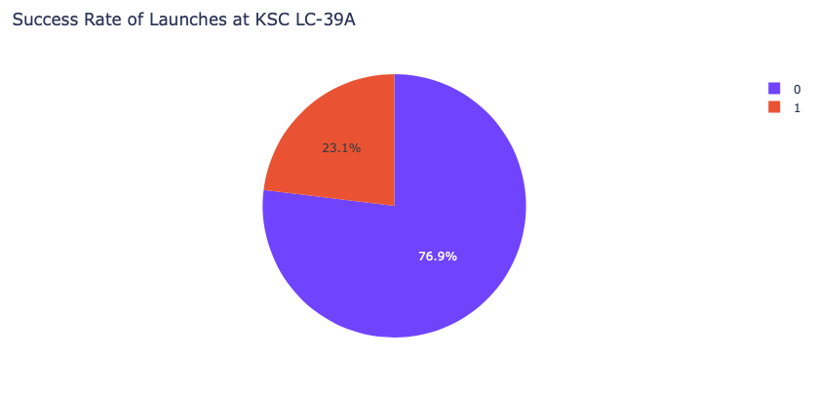
Dashboard: Success Rate of Most Successful Launch Site
Observations
KSC LC-394 has a success rate of 76.9% for launches (0=Failures, 1=Successes).

Slide 42
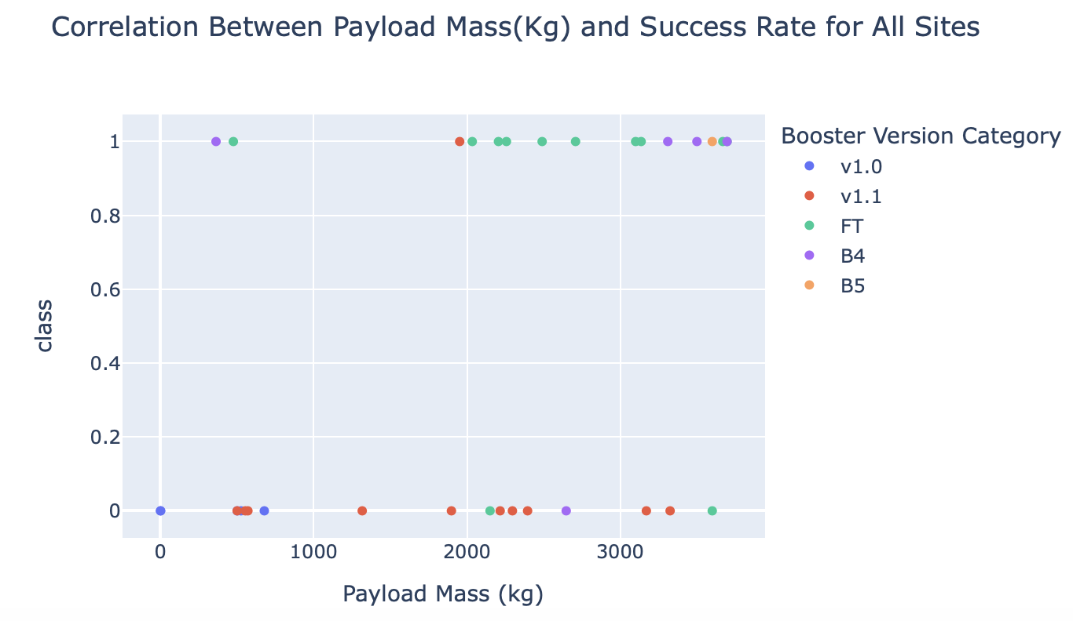
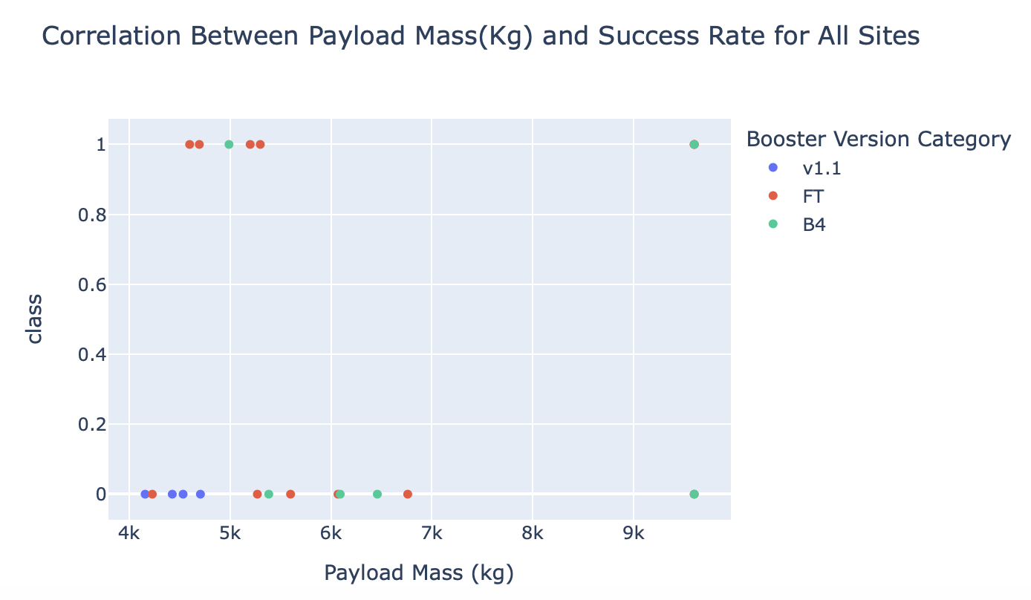
<Dashboard Screenshot 3>
Where Payload Mass between: 0- 4000Kg
Where Payload Mass between: 4000- 10000Kg
Observations
There are more rockets with lower weighted payloads (0-4000Kg) who have successfully landed compared with rockets with a larger payload. This suggests that rockets with a lower payload mass are more successful than rockets with a higher payload mass

Slide 43


Slide 44
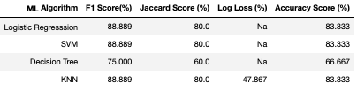
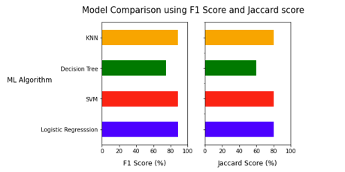
Classification Accuracy
The ML Models were evaluated on the test set using various metrics including; Accuracy Score, F1 score, Jaccard Score, and Log Loss.
SVM, Logistic regression and KNN performed identically in terms of; Accuracy, F1 and Jaccard Score. While the models scored highly they were all susceptible to false positives. The decision tree algorithm performed worse than the others, with it being susceptible to both false positives and false negatives.

Slide 45
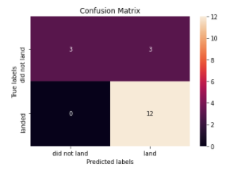
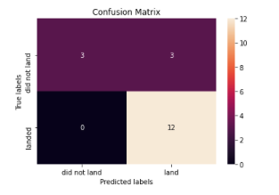
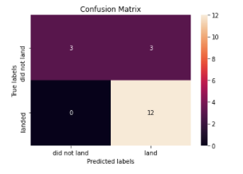
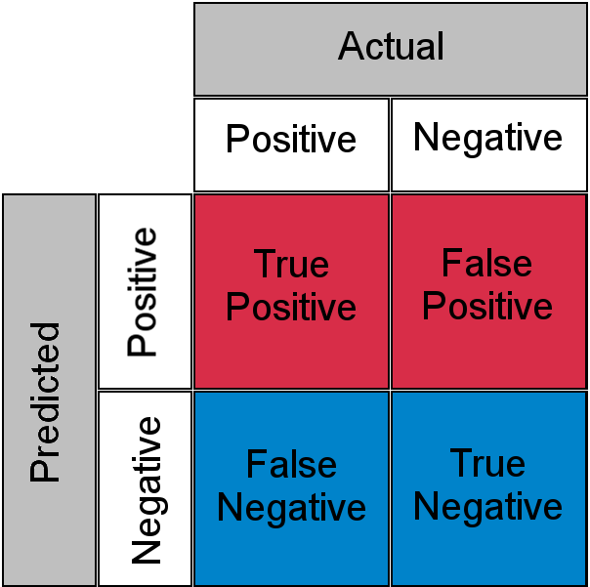
Confusion Matrix
Logistic Regression
SVM
KNN
It’s no surprise that the Logistic Regression, SVM and KNN models all performed identically when being evaluated as they had the exact same number of; True positive, True Negative, False Negatives and False Positives. The models all performed relatively the models main limitation was incorrectly predicting the positive class (because of the three occurrences of False Positives).

Slide 46
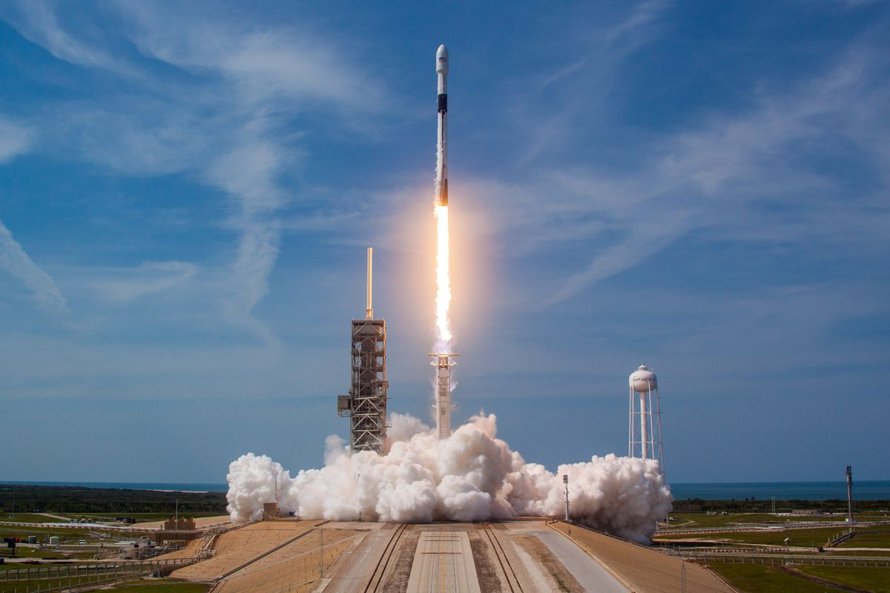
Conclusion
Three ML algorithms performed identically; Logistic Regression, SVM, and KNN. They were equally the best choice for the dataset.
Space X Success Rates:
Rockets with a lower payload mass perform better than rockets with a larger payload mass
Orbit types; GEO, SSO, ES-L1 and HEO are most successful for landing rockets.
KCS LC-39A is the most successful site for launching rockets
From 2013 to the present day, the success rates of Space X have steadily increased and continue to trend upwards.

Slide 47


